Slide 1
Kafka

Slide 2

What is Kafka?
Real time streaming pipelines
Real time stream processing applications

Slide 3
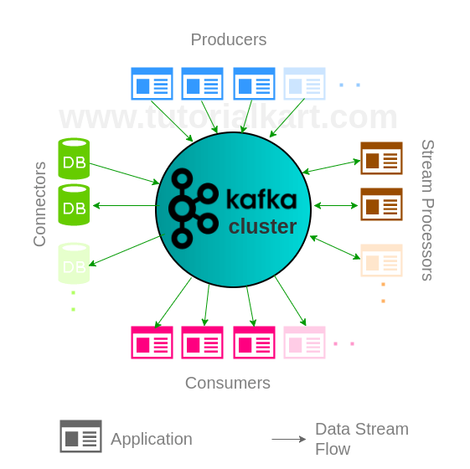
Architecture

Slide 4
Use Cases
Messaging
Tracking website activity
Metrics
Stream Processing
Etc.

Slide 5








A few companies using Kafka

Slide 6
Demo
Processing Twitter data in real time

